Slide 1

Finding the Purrfect Pup
Top Dawgs Project Overview

Slide 2
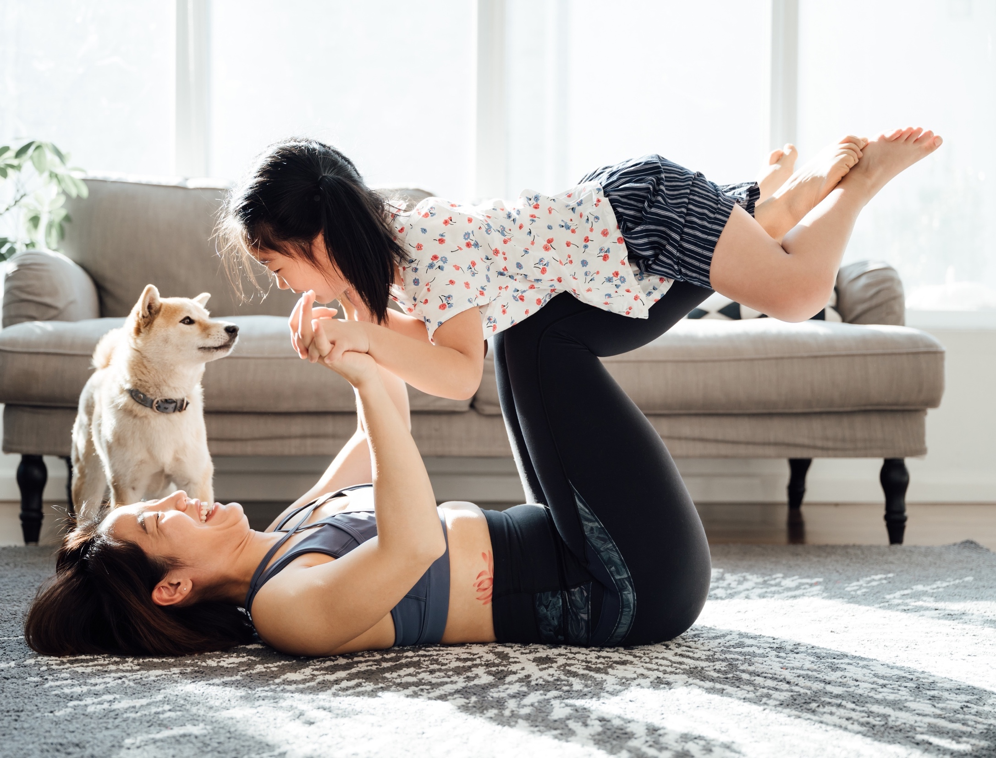
Agenda
01.
Introduction
We will introduce our team, the problem, and our solution.
02.
Live Demo
We will walk through our finished product.
03.
Code Review
We will provide an overview of our code.
04.
Q&A
We will open the floor for questions!
1

Slide 3
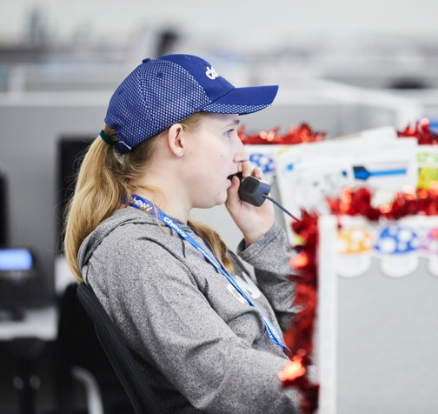
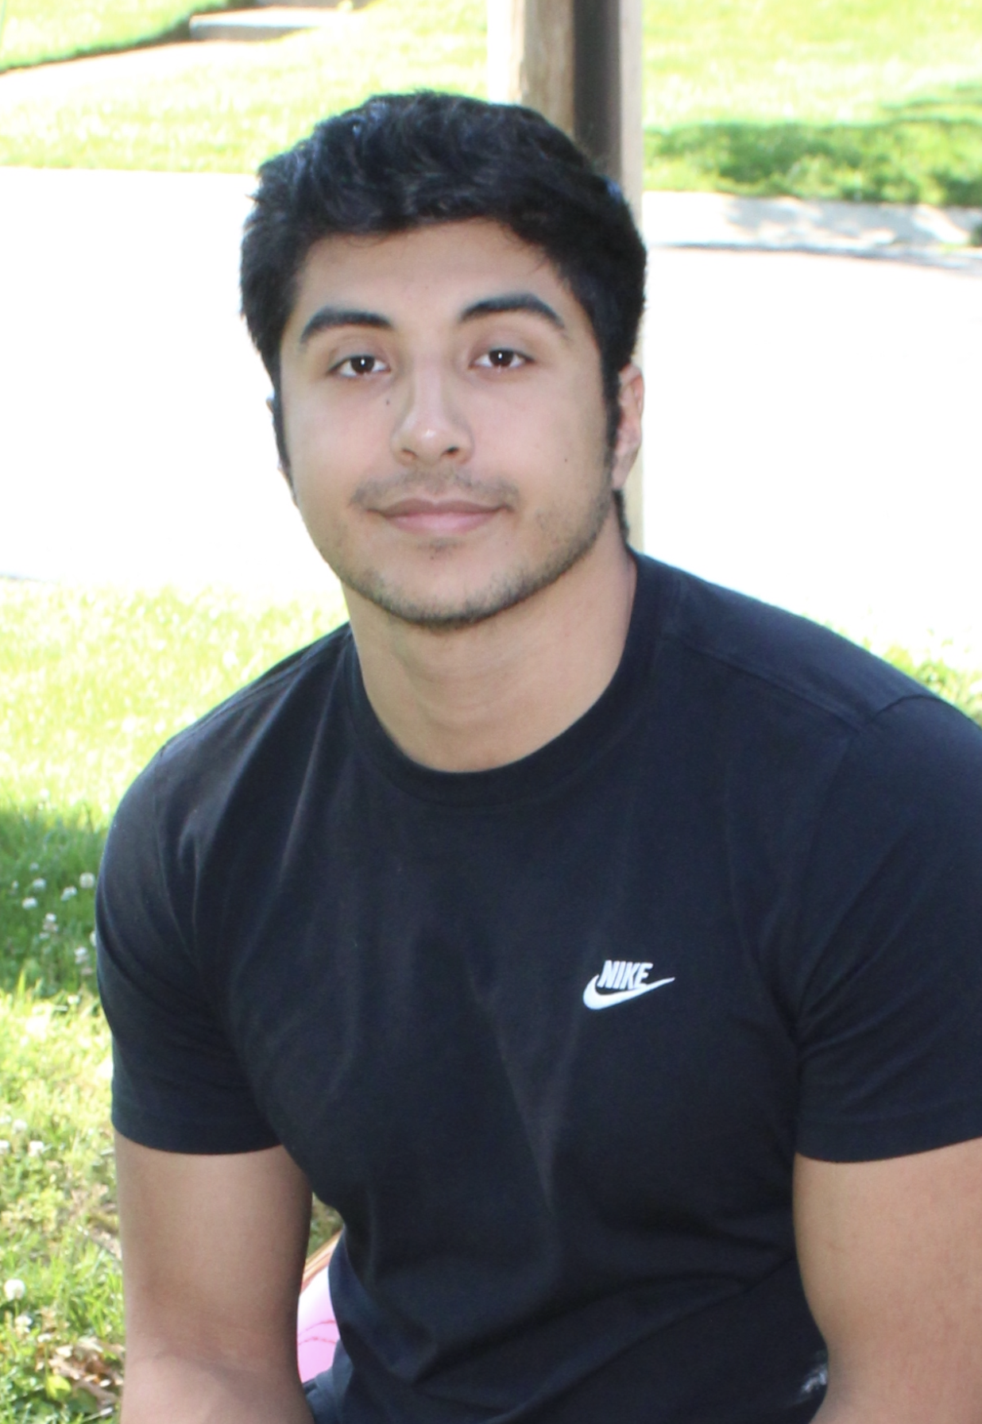
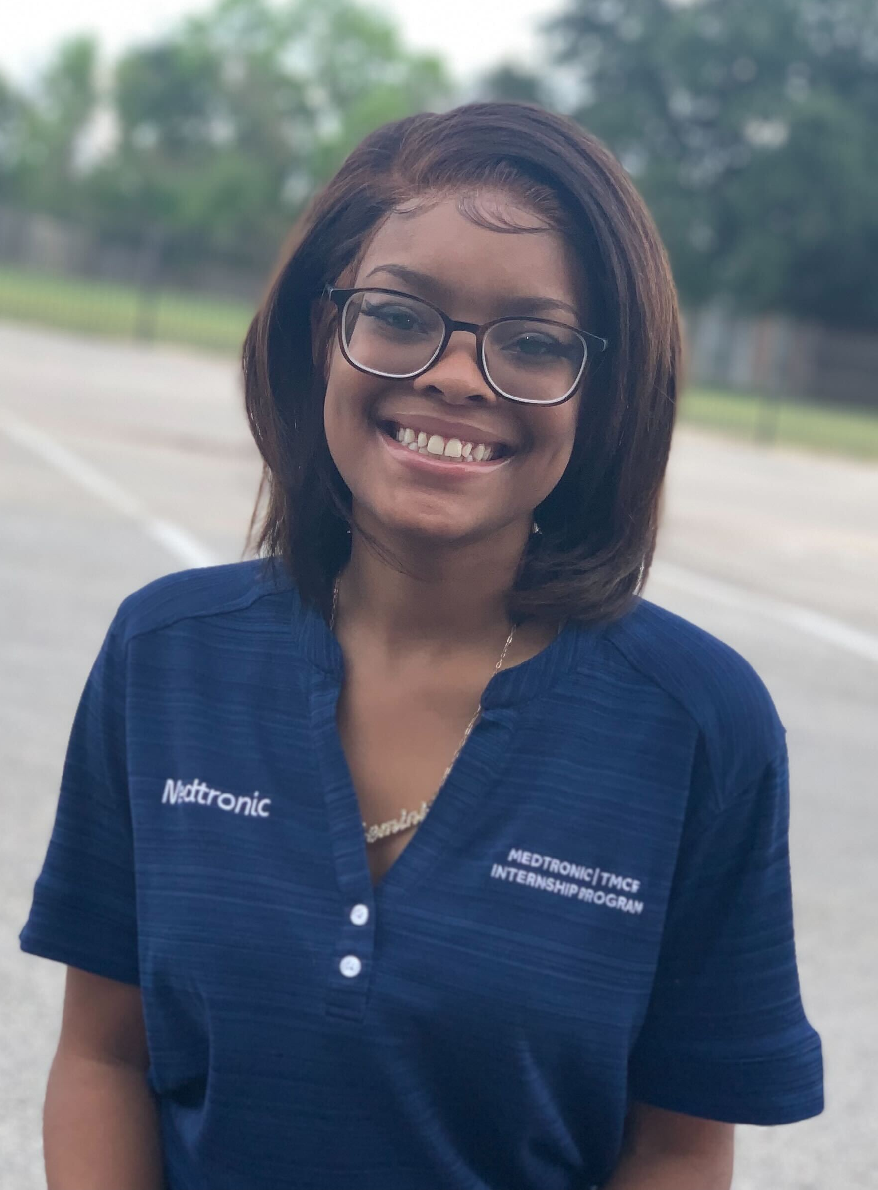
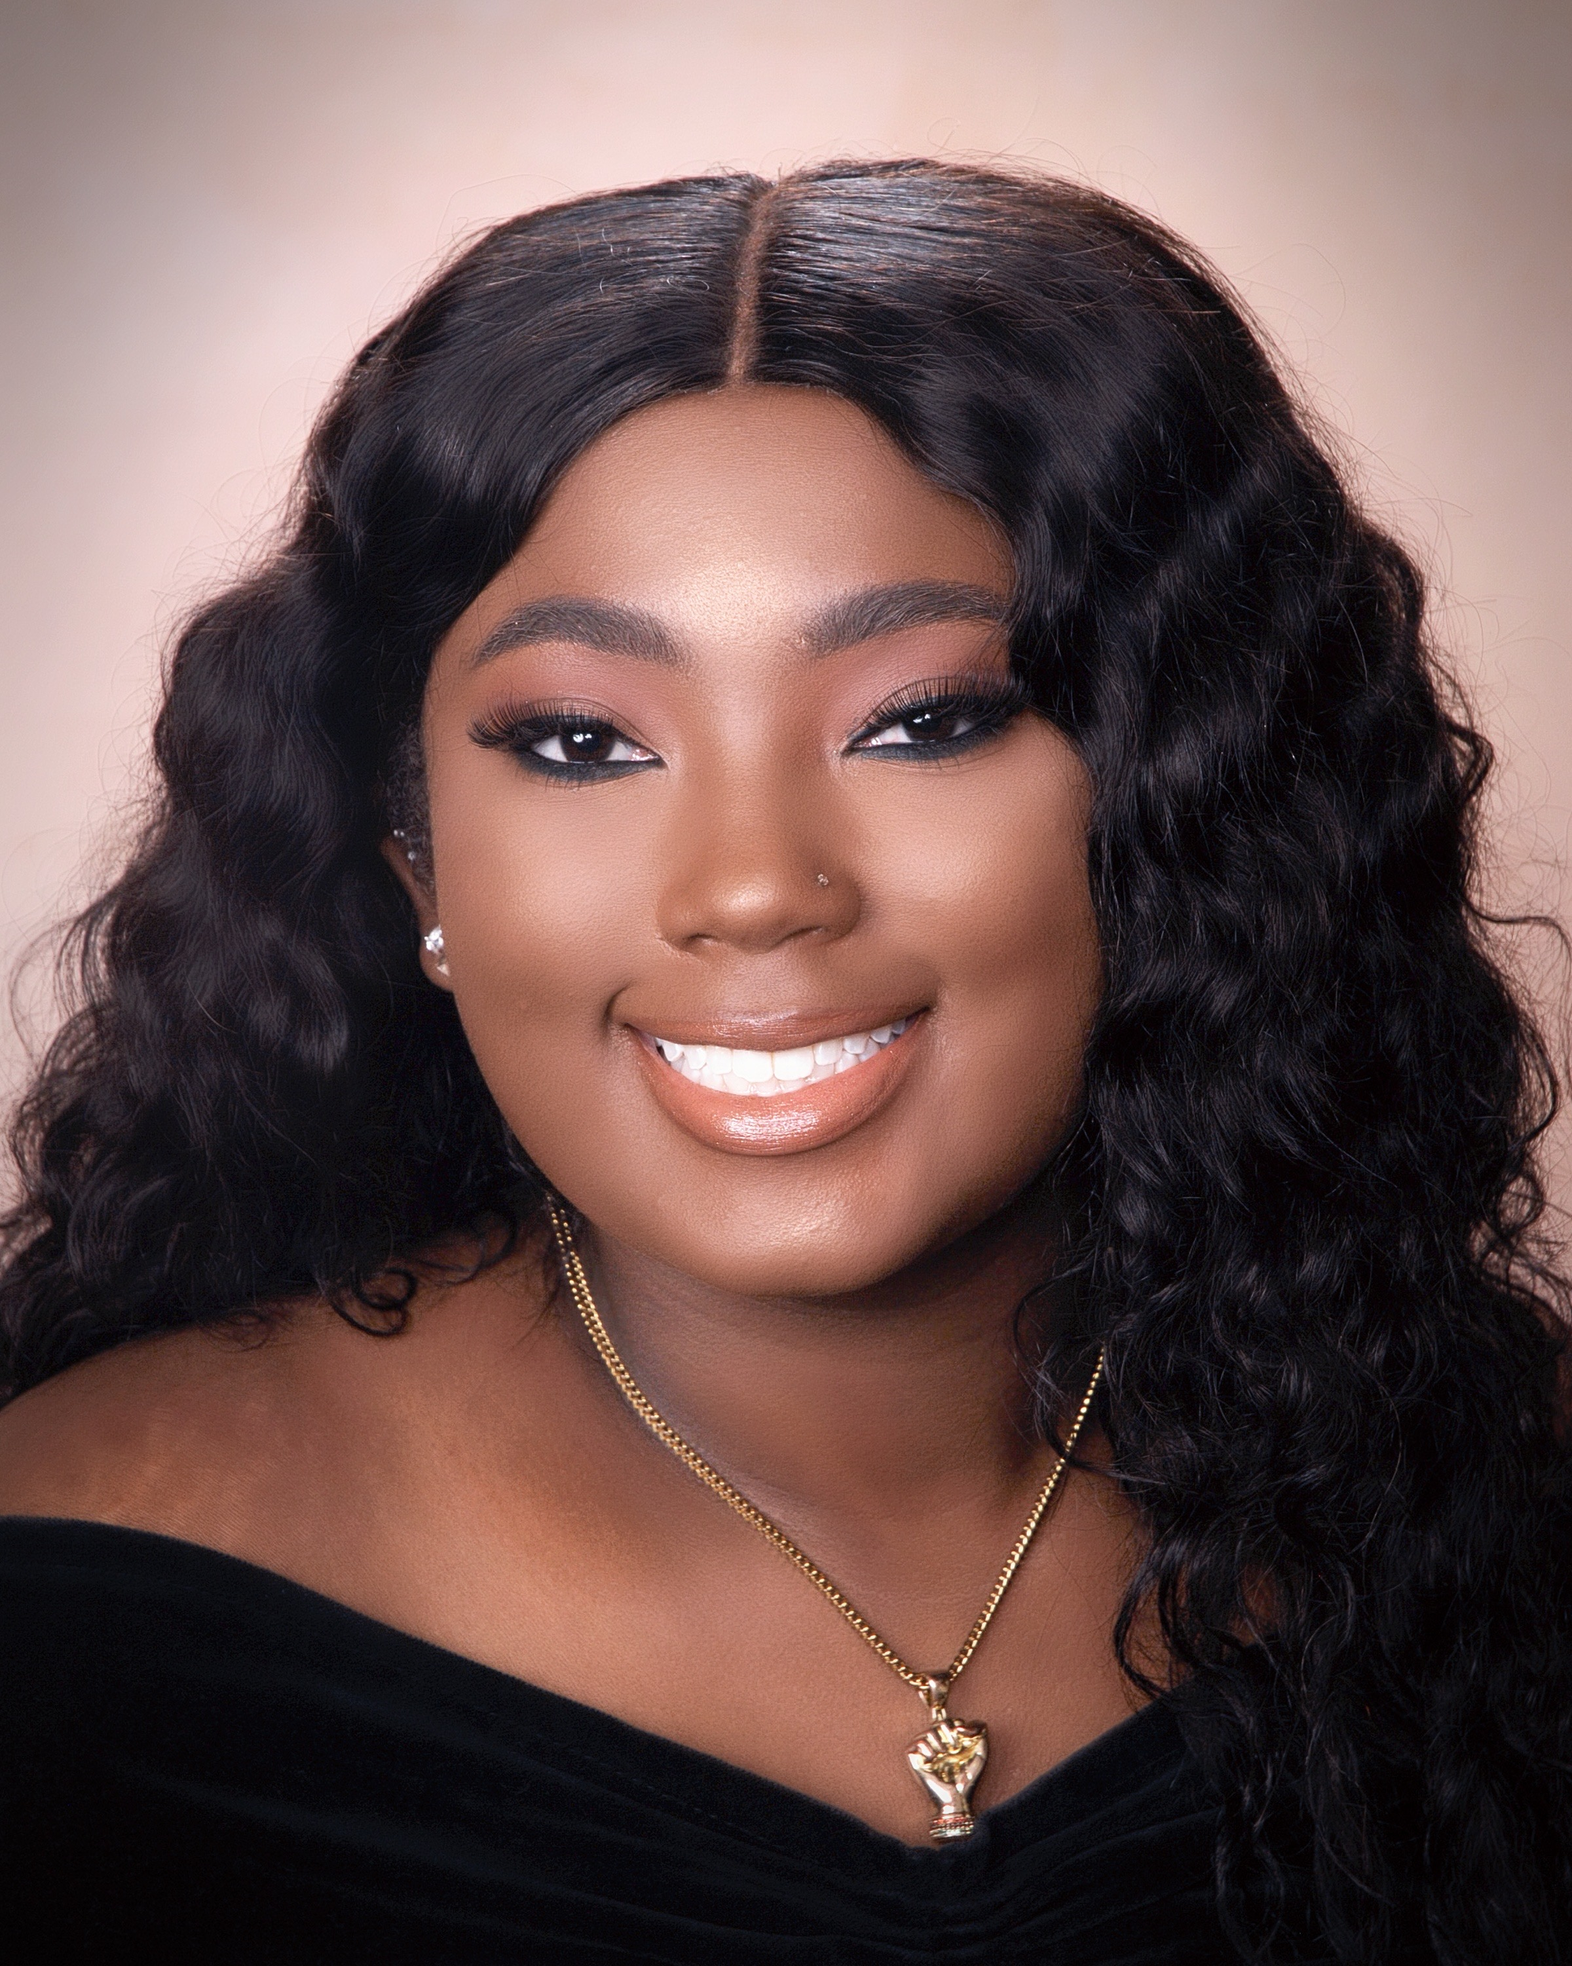

Meet the Team
We are the Top Dawgs
Adonnis Dillard
Senior CS major at NCAT
John Iglesias
CS major at the University of Maryland- College Park
Katerra Stamps
Senior CS major at PVAMU
Kiana Moore
Sophomore Honors CIS major at Howard University
Samir Jaber
Junior CS major at the University of Maryland- College Park
2

Slide 4
01.
CHALLENGE
What is the next big product or service for Chewy?
3

Slide 5
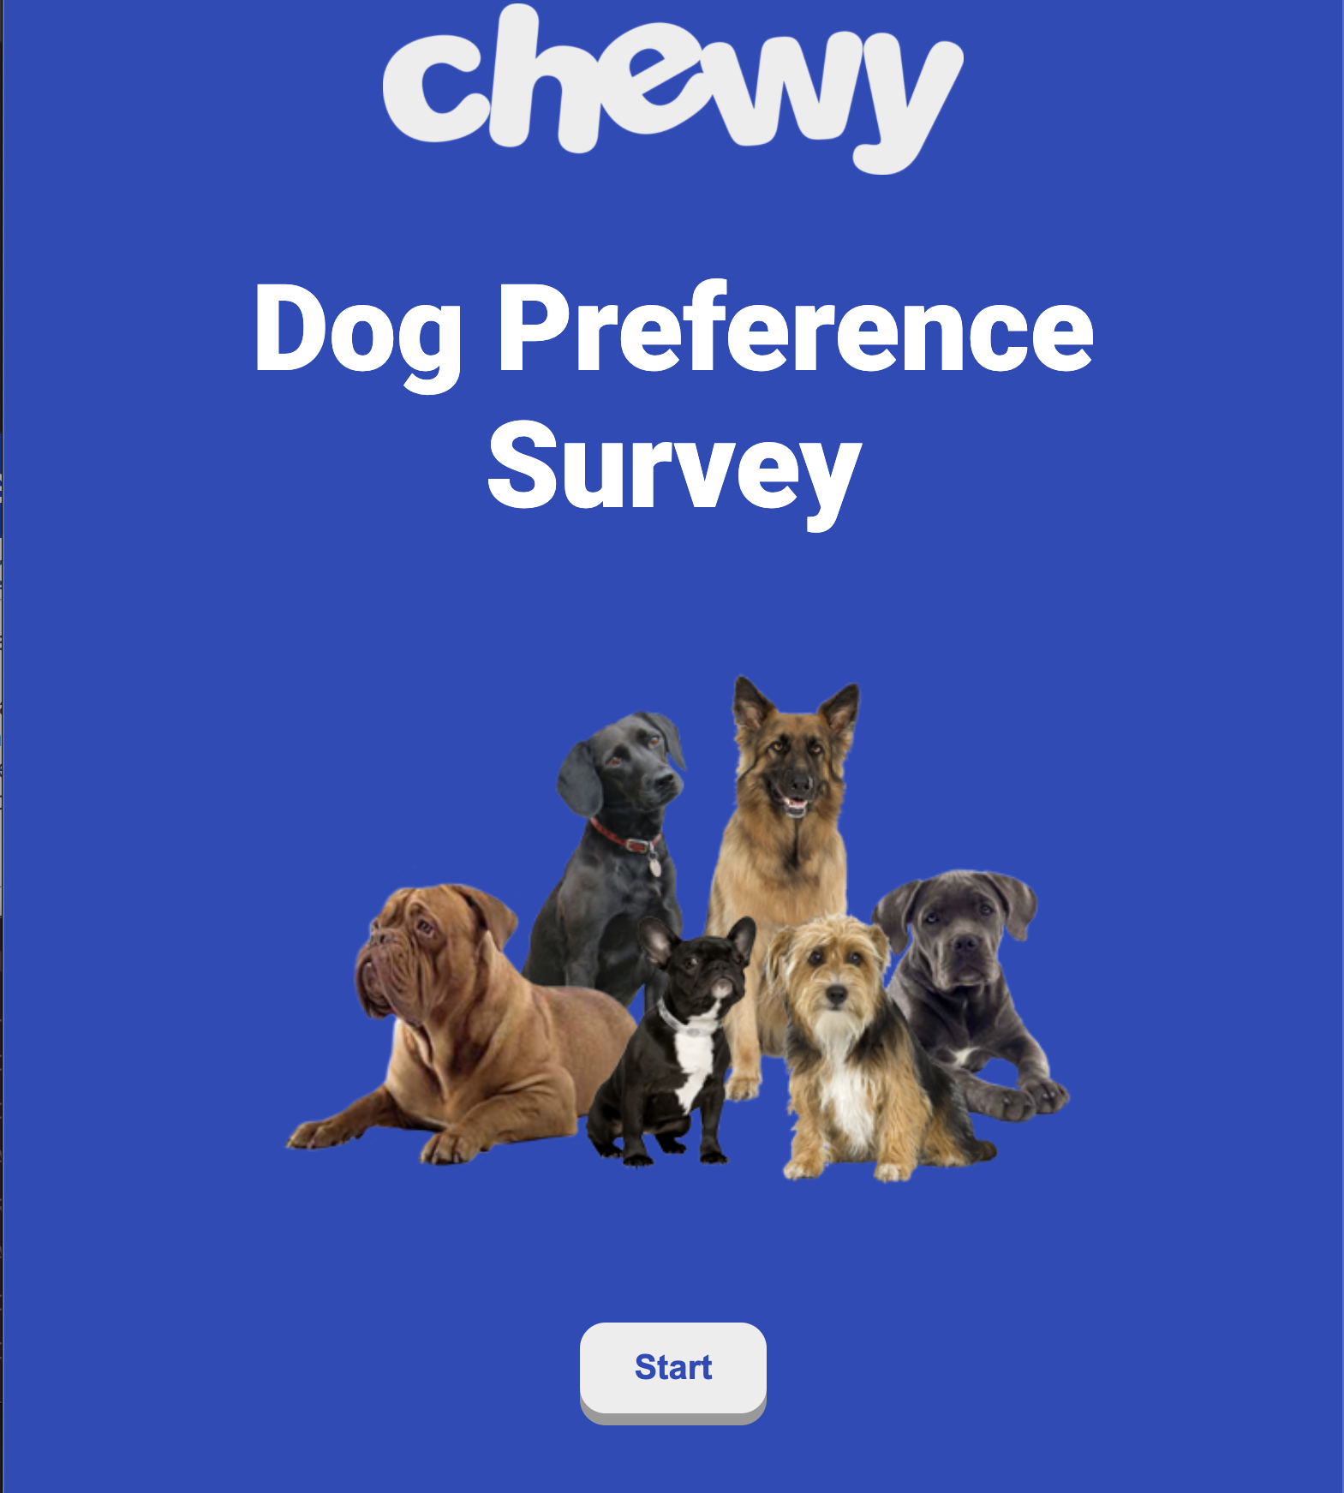
Solution
A survey that suggests the best dog that fits the user’s needs.
Features
Welcoming home page
Dog Preference Survey
Results Page
Chewy Product Suggestions
Languages
HTML
CSS
JavaScript
4

Slide 6
Why?
Users don’t just use our service once. After getting a pet, they may still visit the Chewy Product Suggestions page, which can be integrated with the product suggestions on Chewy’s Pet Profile page.
Being a source of reliable information that helps people choose their dream dog builds trust between Chewy and users. They will always remember our help!
Sustainability
Builds Trust
Our Chewy Product Suggestions feature can also be expanded to suggest subscriptions to Chewy products for Pet Profile users.
This service prioritizes pet health by ensuring a user is suggested the perfect dog for their lifestyle. Knowing the activity levels and maintenance requirements of a dog eliminates health risks In the future.
Autoship
Pet Health
5

Slide 7

Context and Business Motivation
Not Like Other Surveys
Chewy’s dog preference survey comes with product suggestions for pet health that can be continuously updated and accessed via Pet Profiles.
Thoughtful User Experience
We created a dynamic results and profile page that displays personalized information for each user’s preferences.
Expandable
The survey, dog dictionary, and product suggestion library can all be expanded to include more content.
One Size Doesn’t Fit All
We took personalization to the next level by including two additional breed suggestions in addition to a user’s top pick.
6

Slide 8
02.
LIVE
Demo
7

Slide 9
03.
LIVE
Code Review
8

Slide 10
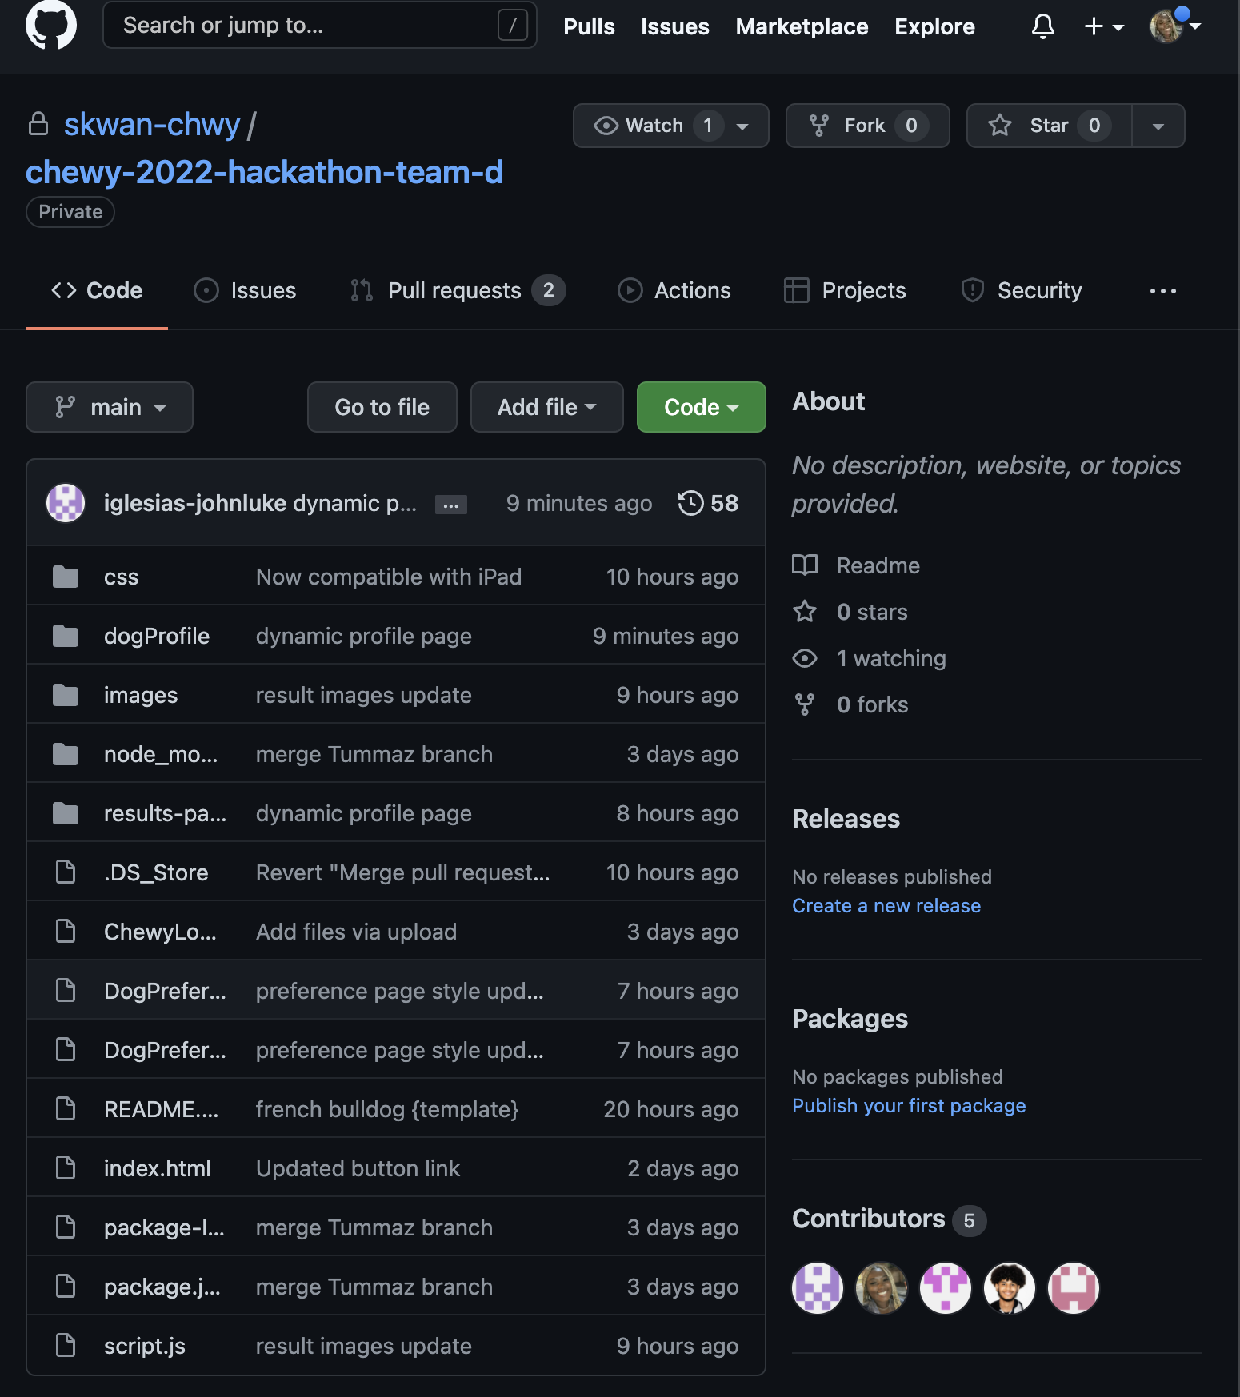
Code Review
Sources:
PNGTree
CreativeCommons

Slide 11
04.
Thank You
Any Questions?
10

